Slide 1
Course Title: Engineering Chemistry-1
Course Code: CHE109
(Chapter 10)
Dr. Joyanta Kumar Saha
Associate Professor
Department of Chemistry
Jagannath University

Slide 2
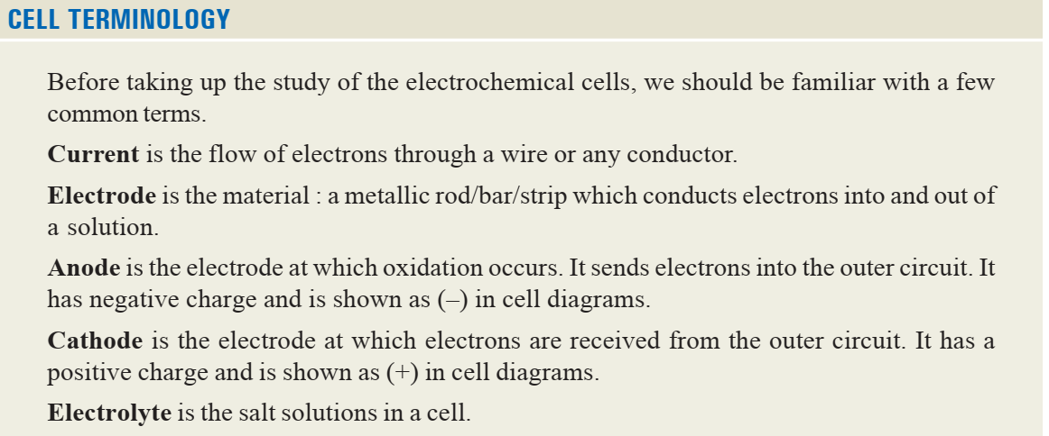
Electrochemistry

Slide 3
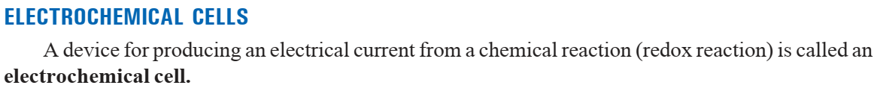
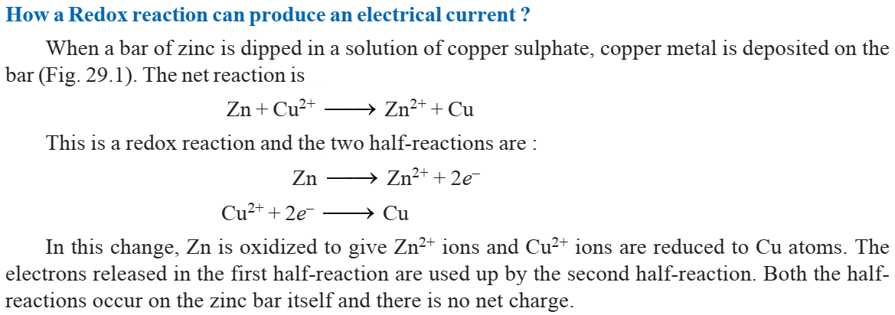

Slide 4
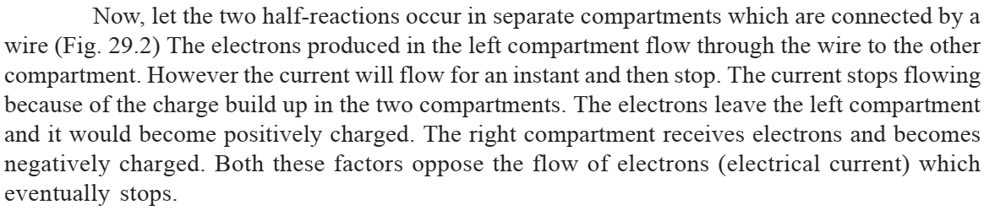
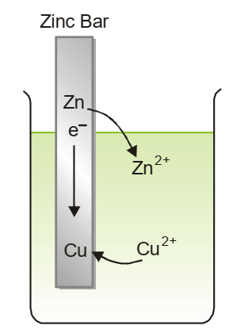
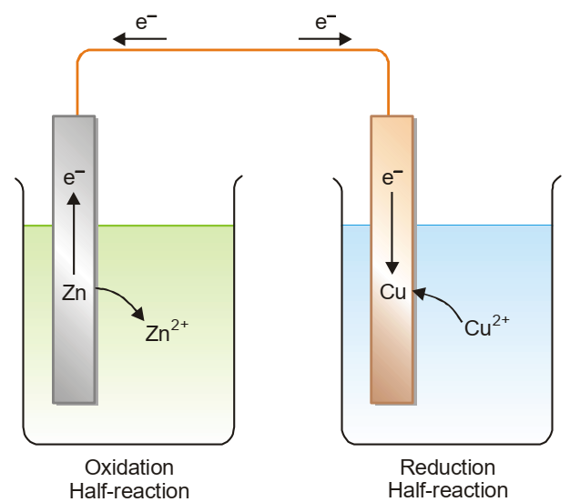
Salt Bridge

Slide 5

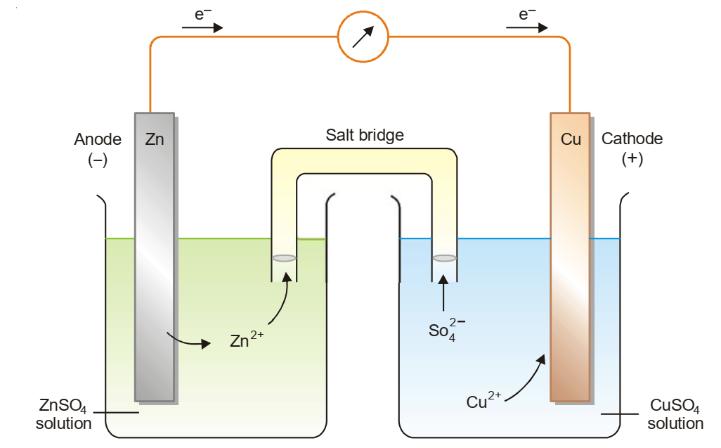

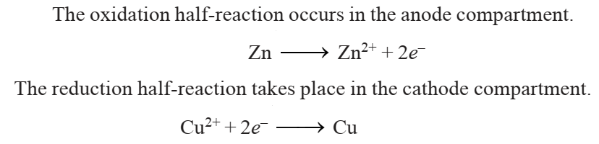
Galvanic cell: A Voltaic cell, also known as a galvanic cell is one in which electrical current is generated by a spontaneous redox reaction. Here the spontaneous reaction of zinc metal with an aqueous solution of copper sulphate is used. When the cell is set up, electrons flow from zinc electrode through the wire to the copper cathode. As a result, zinc dissolves in the anode solution to form Zn2+ ions. The Cu2+ ions in the cathode half-cell pick up electrons and are converted to Cu atoms on the cathode. At the same time, ions from the cathode half-cell migrate to the anode half-cell through the salt bridge. Likewise, Zn2+ ions from the anode half-cell move into the cathode half-cell. This flow of ions from one half-cell to the other completes the electrical circuit which ensure continuous supply of current. The cell will operate till either the zinc metal or copper ion is completely used up.
A simple voltaic (galvanic) cell

Slide 6
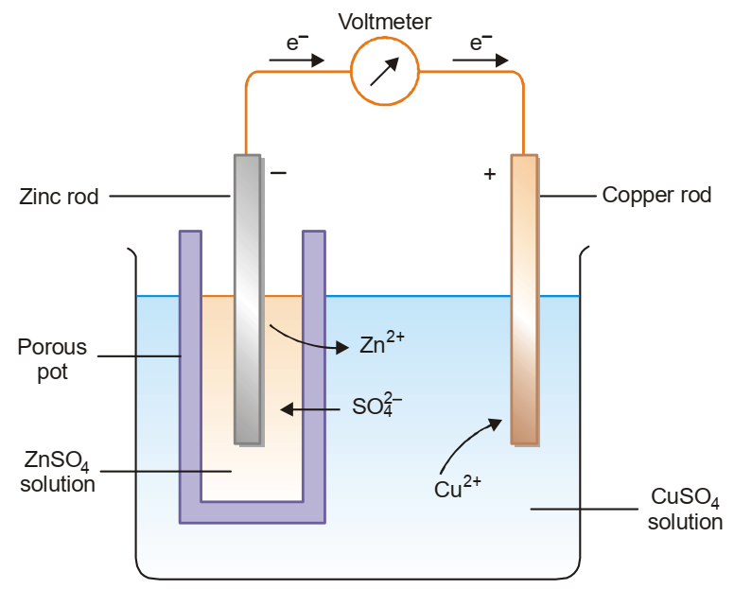
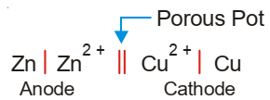
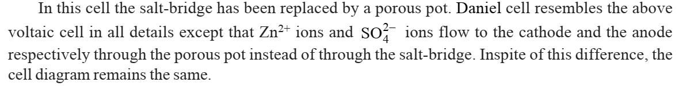

Slide 7
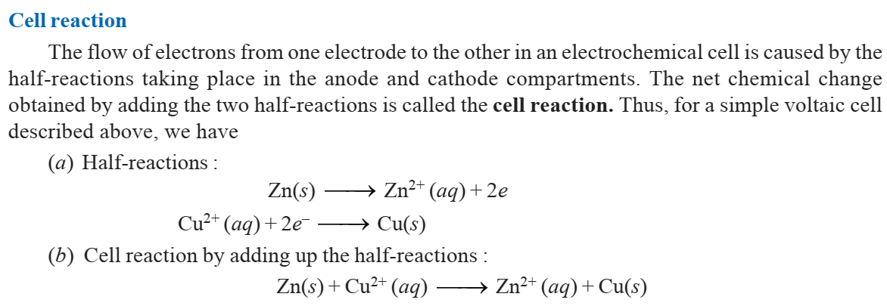

Slide 8
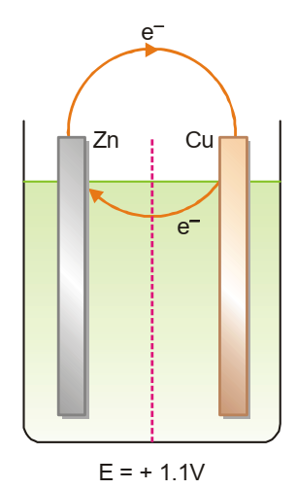

Electromotive Force (E): The electromotive force of a cell or EMF of a cell is the maximum potential difference between two electrodes of a cell. It can also be defined as the net voltage between the oxidation and reduction half-reactions. The electrons are transported through the cell solution by ions present and pass from the positive electrode (Cu in case of Daniel cell) to the negative electrode. This corresponds to a clockwise flow of electrons through the external circuit. Thus the emf of the cell is given the +ve sign. The emf of cell potential is measured in units of volts (V) and is also referred to as cell voltage.
where E_{R} and E_{L} are the reduction potentials of the right-hand and left-hand electrodes respectively.

Slide 9
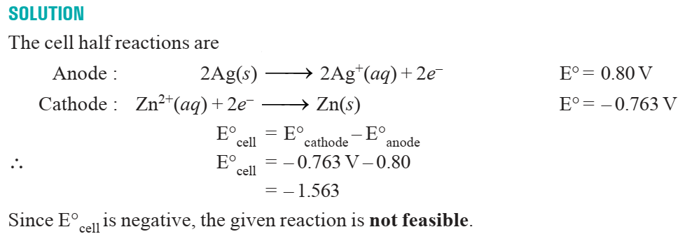
Predicting Feasibility of Reaction The feasibility of a redox reaction can be predicted with the help of the electrochemical series. The net emf of the reaction, Ecell, can be calculated from the expression E°cell = E°cathode – E°anode In general, if E°cell = + ve, the reaction is feasible E°cell = – ve, the reaction is not feasible
SOLVED PROBLEM 1. Predict whether the reaction is feasible or not. 2 Ag(s) + Zn2+ (aq) ⎯⎯→ Ag+ (aq) + Zn(s)

Slide 10

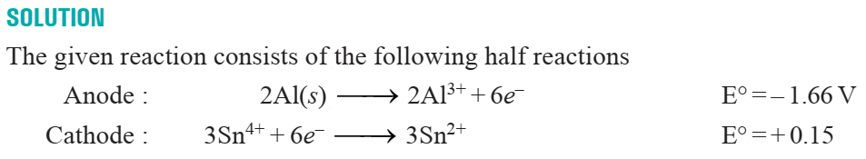
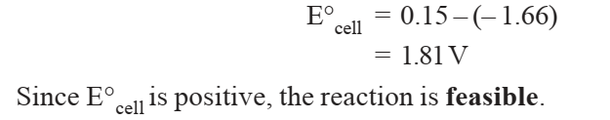

Slide 11
Standard emf of a cell: It can be measured with the help of a potentiometer. The value of emf varies with the concentration of the reactants and products in the cell solutions and the temperature of the cell. When the emf of a cell is determined under standard conditions, it is called the standard emf. The standard conditions are (a) 1 M solutions of reactants and products; and (b) temperature of 25°C. Thus standard emf may be defined as : the emf of a cell with 1 M solutions of reactants and products in solution measured at 25°C. Standard emf of a cell is represented by the symbol E°.
Determination of emf of a half-cell: There is no way of measuring the emf of a single half-cell directly. A convenient procedure to do so is to combine the given half-cell with another standard half-cell. The emf of the newly constructed cell, E, is determined with a voltmeter. The emf of the unknown half-cell, E, can then be calculated from the

Slide 12

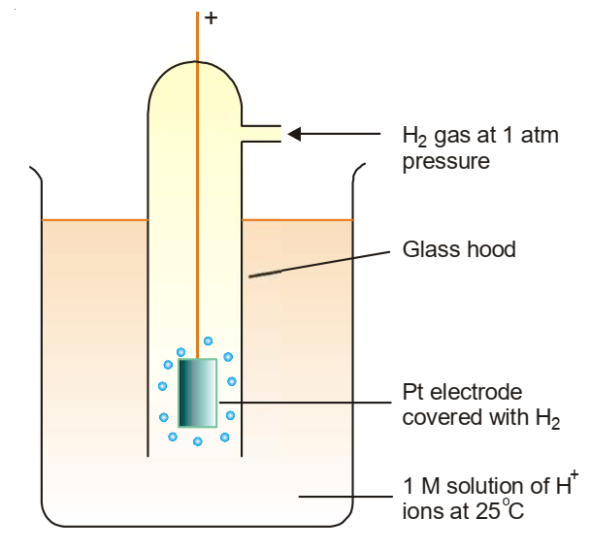
Expression. Emeasured = E_{R} – E_{L} If the standard half-cell acts as anode, the equation becomes. E_{R} = Emeasured (∵ E_{R} = 0) On the other hand, if standard half-cell is cathode, the equation takes the form E_{L}= – Emeasured (∵ E_{L} = 0)
Standard Hydrogen Electrode (SHE): It consists of a platinum electrode immersed in a 1 M solution of H+ ions maintained at 25°C. Hydrogen gas at one atmosphere enters the glass hood and bubbles over the platinum electrode. The hydrogen gas at the platinum electrode passes into solution, forming H+ ions and electrons.
The emf of the standard hydrogen electrode is arbitrarily assigned the value of zero volts. So, SHE can be used as a standard for other electrodes.

Slide 13
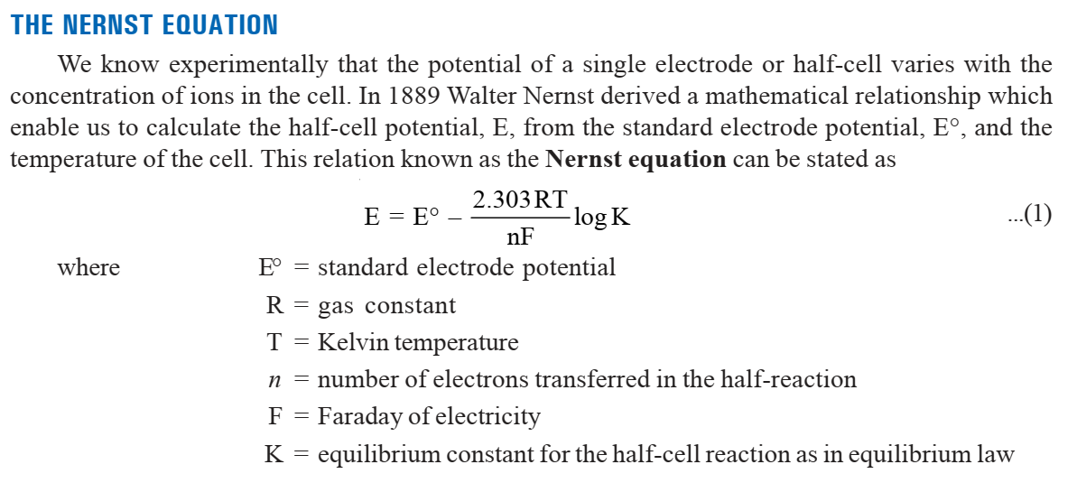
Reduction potential: The reduction potential of a species is its tendency to gain electrons and get reduced.

Slide 14
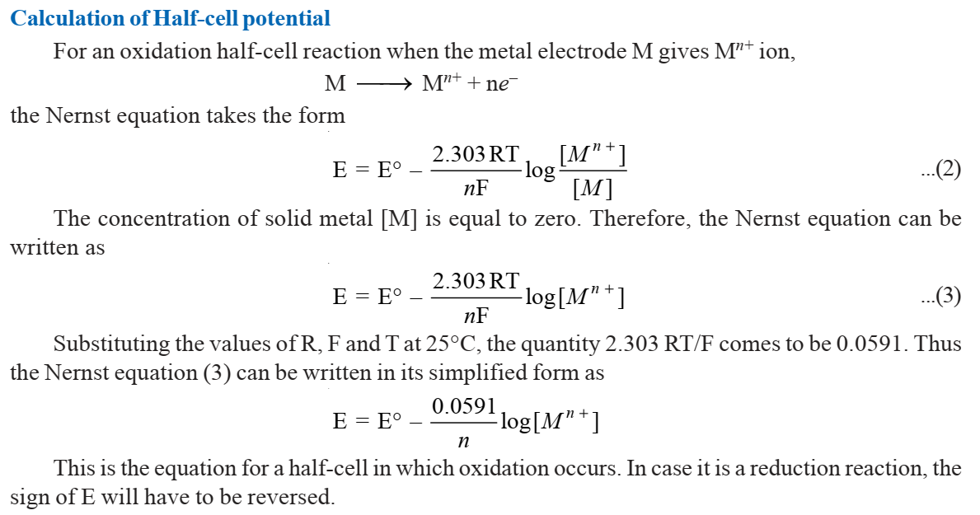

Slide 15
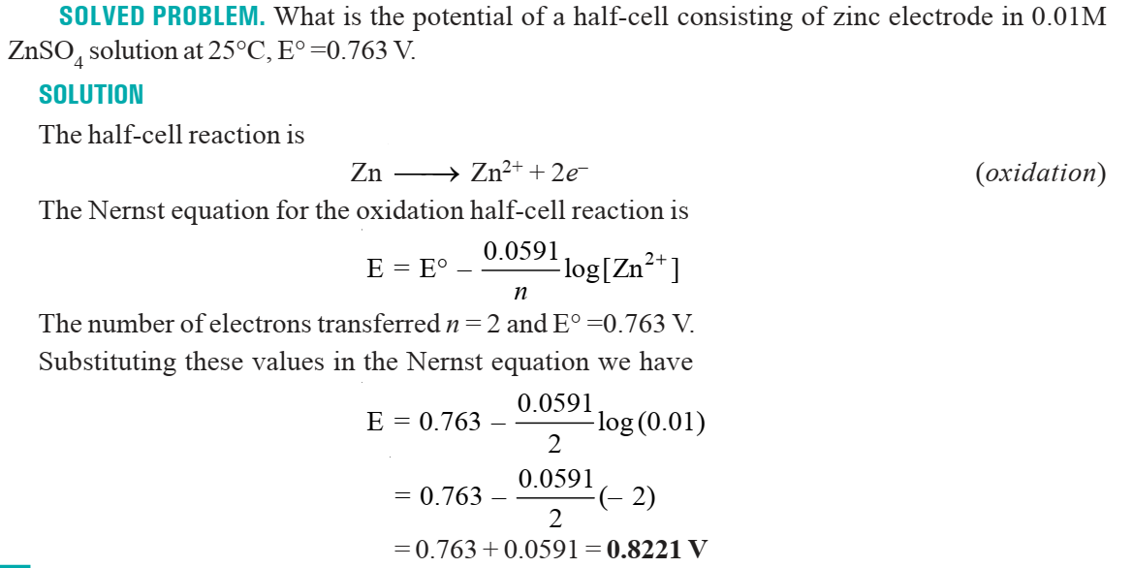

Slide 16
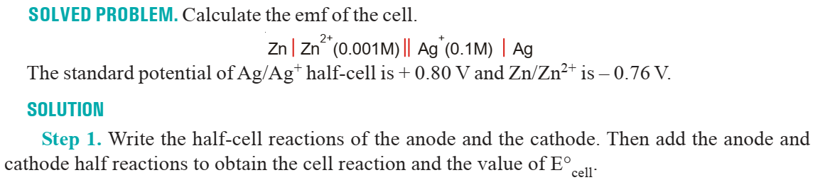
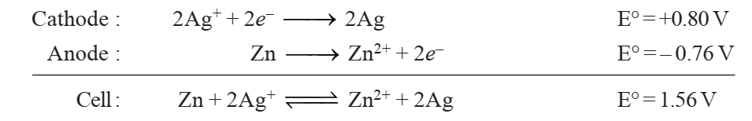
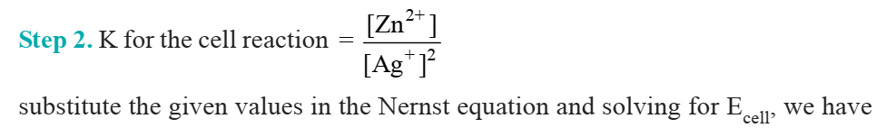

Slide 17
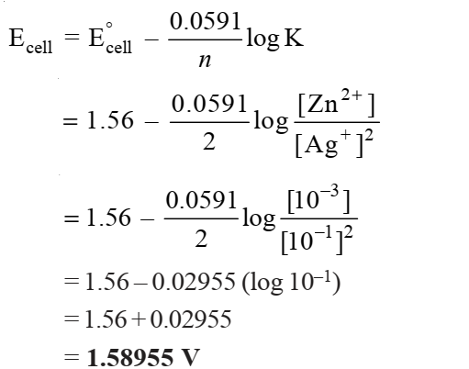

Slide 18
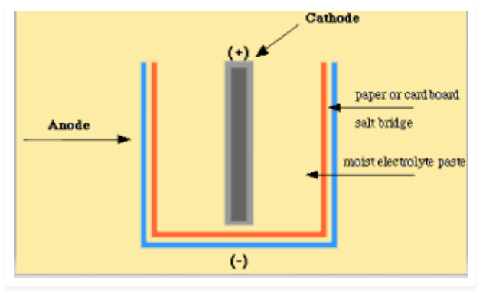
Zinc-Carbon dry cell: A dry cell consists of a metal container in which a low moisture electrolyte paste covers the graphite rod or a metal electrode. Generally, the metal container will be zinc whose base acts as a negative electrode (anode) and a carbon road acts as a positive electrode (cathode). It is surrounded by manganese dioxide and low moisture electrolyte like ammonium chloride paste, which will produce a maximum of 1.5V of voltage, and they are not reversible.
During the process, a reduction reaction occurs within the moisturized electrolyte, which comprises manganese dioxide (MnO₂) and ammonium chloride (NH₄Cl) and graphite serves as solid support for the reduction reaction
2NH₄⁺ + 2MnO₂ →Mn₂O₃ + 2NH₃ + H₂O
Step 2:
Zinc container serves as an anode and undergoes an oxidation reaction
Zn → Zn²⁺ + 2^{e-}
Zinc-carbon cell is the most common dry cell and is also called Leclanche cell.

